Slide 1

Meltdown: Reading Kernel Memory from User Space
April 2021, By Moritz et. Al
Presented by Ryan W. West, ryan@ryanwwest.com

Slide 2

Meltdown
The Meltdown attack bypasses user/kernel memory isolation
Allows any user process to read the entire kernel memory
Exploits not software but a hardware side-channel vulnerability
This makes it difficult to fix, but there is a temporary solution
Affects most Intel processors since 2010 and some ARM processors
Notes:
For example, this can allow one user process to read data from another process, without privileges

Slide 3
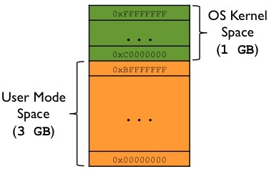
Background: Memory Isolation
Memory Isolation is a central security feature of today’s Operating Systems
Ensures that a user process can only access its own process memory, not kernel memory
Realized via a supervisor bit in the processor that determines if a kernel memory page can be accessed
When the kernel must be invoked special kernel functions are called which set this bit to gain access to all memory
Notes:
For example, kernel must be invoked for interrupt handling

Slide 4
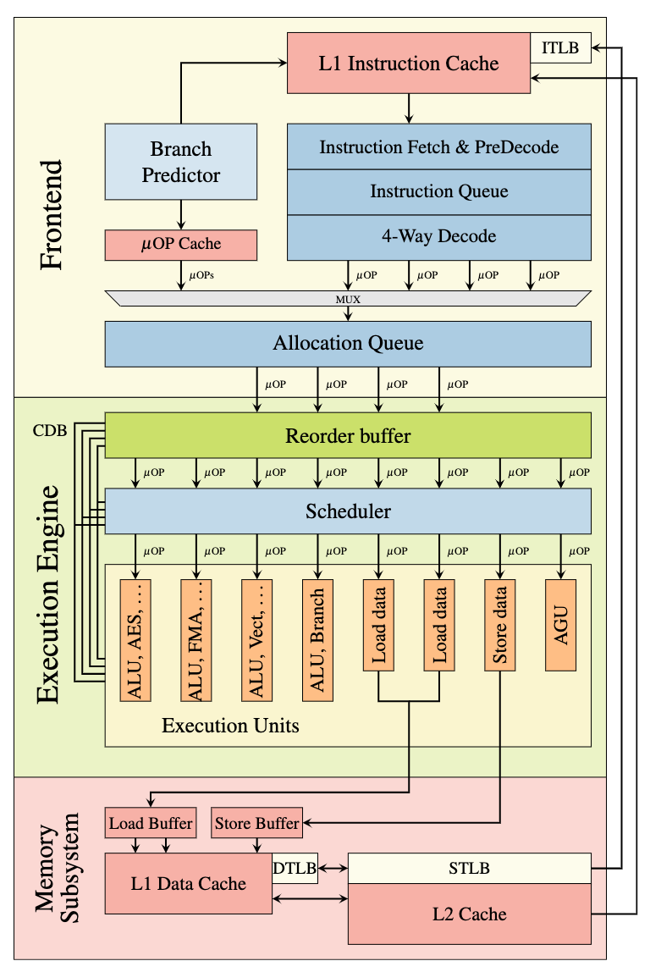
Background: Out-of-order Execution
CPU optimization technique that “allows maximizing the utilization of all execution units of a CPU core as exhaustively as possible”
Benefit: faster processing times
Instead of processing instructions strictly in sequential program order, CPU looks ahead and may execute future instructions as soon as execution units are available
CPU may run instructions speculatively: it may run instructions that are never reached sequentially
This has unintended side effects
Notes:
An example of this is running instructions after a branch, not knowing that the branch is taking

Slide 5
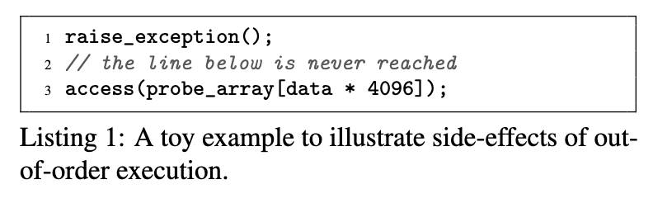
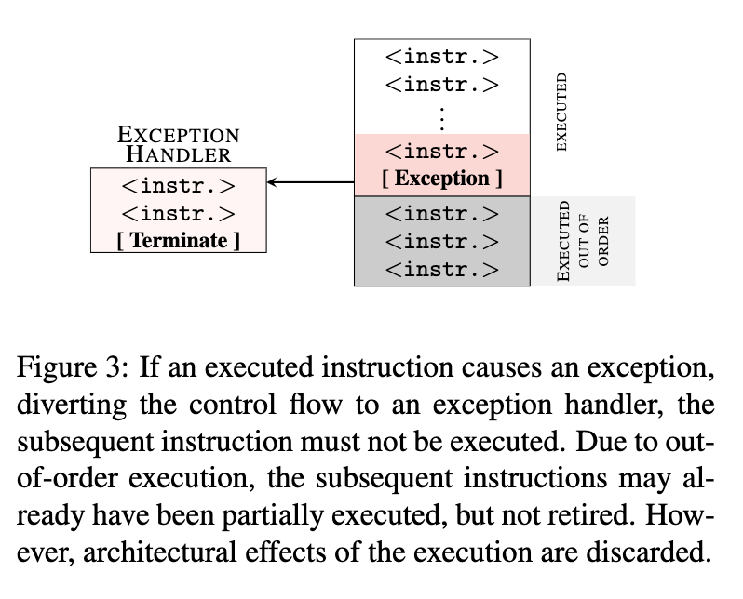
Out-of-order Execution Example
The example cannot access the array in memory because the exception traps to kernel and terminates the application
But the CPU might have already executed the access instruction
This leads to microarchitectural side effects: the discarded memory access’s contents still reside in the cache

Slide 6
Background: Cache Attacks
CPUs contain small, fast memory buffers to reduce latency when accessing frequently used data
Often known as L1, L2, L3 caches
An attacker can exploit timing differences introduced by the caches by flushing (emptying) it
This is known as the Flush+Reload attack, which is used in this paper, but other types of attacks can also be used
Notes:
“By measuring the time it takes to reload the data, the attacker determines whether data was loaded into the cache by another process in the meantime”
The flush portion of the attack can be realized with a special flush processor instruction which I assume alerts the cache

Slide 7
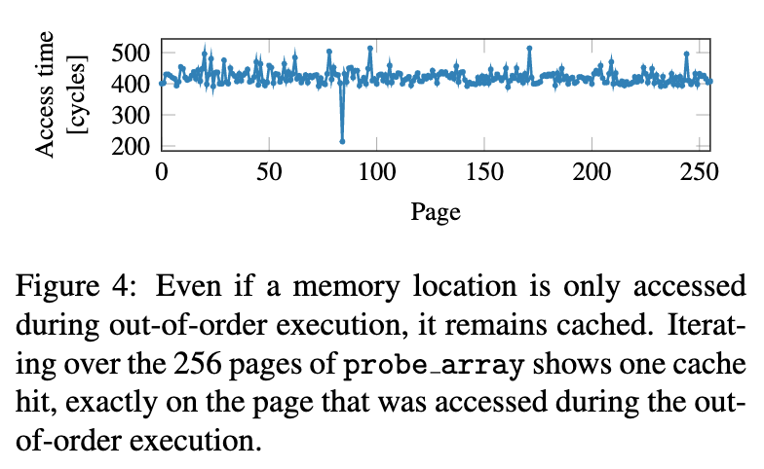
Out-of-order Execution Example
Because the kernel memory array still resides in the cache we can use a Flush+Reload cache attack to determine which page of memory was loaded
Page 84 was a cache hit
Thus memory is indeed in the cache; it is the only hit because of the recent flush
This occurs even though the access should have never happened, can be used to leak information

Slide 8
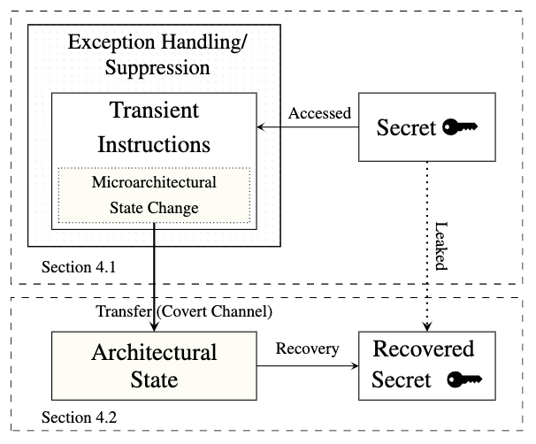
Meltdown Attack: Building Blocks
Make the CPU execute 1+ instructions that would never occur in the executed path
These are called transient instructions and are executed out-of-order and leave side-effects
Target a specific secret in kernel memory
Transfer the resulting side-effect to a process
Notes:
There are two building blocks that we need to combine in order to carry out the full meltdown attack
Explain microarchitectural vs architectural

Slide 9
Building Block 1: Executing Transient Instructions
Some approaches:
Exception Handling: Create a child process before accessing the ‘invalid’ memory; CPU executes transient instruction sequence in child process before crashing, then parent process recovers the secret
Exception Suspension: Prevent exceptions from being raised at all with transactional memory
Groups memory accesses into atomic operations with the ability to roll-back if an error occurs
If an exception occurs in the transaction, architectural state is reset and program continues
Notes:
For exception handling, you could also use a signal handler

Slide 10
Building Block 2: Recovering the Secret
Goal: go from microarchitectural state (secret in cache) to architectural state (secret in user memory (i.e. program variable))
We can use the flush+reload cache attack technique to recover the secret
Fastest to read 1 bit at a time from the cache, repeating the whole process each time
Notes:
Can use a different thread or process to recover this, or the same one You can read multiple bits at once, but it is slower
There is a lot of detail left out here

Slide 11
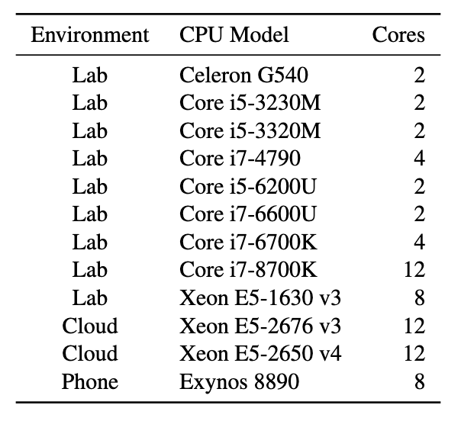
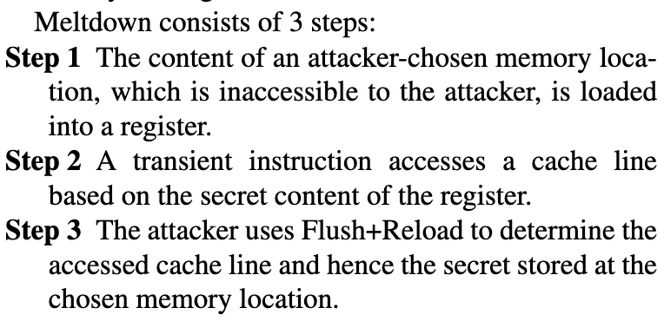
Implementation
Assume OS has no flaws and processor uses ASLR, KASLR, etc
Written in assembly, not C (as in previous examples)

Slide 12
Problem: Inherent Bias Towards 0
The illegal, transient memory load often returns a 0
(normally, ~50% of bits are 0s and ~50% are 1s)
This is a race condition
Error probability: up to 5.25% depending on processor
Solution: “Retry reading the address in the transient instruction sequence until it encounters a [1]“
Retrying a few times lowers race condition probability
With the optimization, error probability drops to 0.003% - 0.67% depending on processor
Notes:
This can happen because “Memory load is masked out by a failed permission check, or a speculated value because the data of the stalled load is not available yet” I don’t think they retry forever, just a few times to be more confident that the value really is a 0 The paper covers other optimizations and limitations, but for sake of time they are omitted here

Slide 13
Optimized Implementation Results
L1 cache performance: average reading rates of up to 582 KB/s with an error rate as low as 0.003%
L3 cache performance: average of 12.4 KB/s with an error rate as low as 0.02%
Uncached secret performance: 10 B/s to 3.2 KB/s depending on more optimizations
Meltdown can retrieve all user and kernel memory from Linux, Android, and almost all of Windows 10.
It also worked on containers and virtual machines
AMD CPUs were immune and only the ARM Cortex-A75 is vulnerable, but they could not test it
Notes:
L1 cache results based on Core i7-8700K processor, 10 runs 10 times each Includes KASLR - where memory is randomized Linux Kernels 2.6.32 to 4.13.0

Slide 14
Countermeasures
Disable out-of-order execution
Poor solution: Modern processors heavily rely on the performance gains achieved with out-of-order execution
KASLR: Kernel Address Space Layout Randomization
Barely helps: KASLR randomizes the location of kernel code, but only up to 40 bit of distance; you can cover the 40-bit search space in 128 tests in the worst case
Kernel page-table isolation (KPTI, previously KAISER)
A software kernel modification that ensures almost no valid mappings to kernel or physical memory in user space
KPTI was not created to mitigate Meltdown but inadvertently counteracts it; it has been deployed everywhere
Introduce a hard split of user space and kernel space
Could be difficult to accomplish in hardware without performance hits, but a potential long-term fix

Slide 15
Summary
What: The Meltdown attack bypasses memory isolation completely, allowing an attacker to read all physical and kernel memory without authorization
How: Meltdown combines a side-effect of out-of-order execution and a cache attack such as Flush+Reload to read data from kernel space
Experiment Results: Authors were able to perform this attack on many Intel CPUs since 2010
Countermeasures: KPTI largely mitigates Meltdown, but as this is a hardware vulnerability, architecture changes will need to be made to completely prevent it from happening

Slide 16
Final Thoughts
Our class project focuses on implementing and analyzing Meltdown in a Linux virtual machine
Meltdown brings to light the fact that so many hardware optimizations were likely designed with only performance and power-savings in mind, not security
As a result, there are likely many different vulnerabilities, and numerous side-attacks can exploit them
Going forward, we must design all hardware and software components with security in mind
Notes:
This doesn’t necessarily mean every component must be 100% secure by all experts’ definitions. Rather, security concerns should be considered. In some cases, it may not matter, but in some cases it will.

Slide 17

Image Sources
https://gabrieletolomei.wordpress.com/miscellanea/operating-systems/virtual-memory-paging-and-swapping/
Wikipedia meltdown page
https://mlq.me/download/meltdown.pdf (Meltdown paper PDF itself)

